Slide 1
Lecture 2:
Nearest Neighbor and Linear Classification

Slide 2
A few updates
There will be no midterm!
But there will be a final!
December 16 (to be confirmed) in Totman. 8am-10am.
More on final projects later.

Slide 3
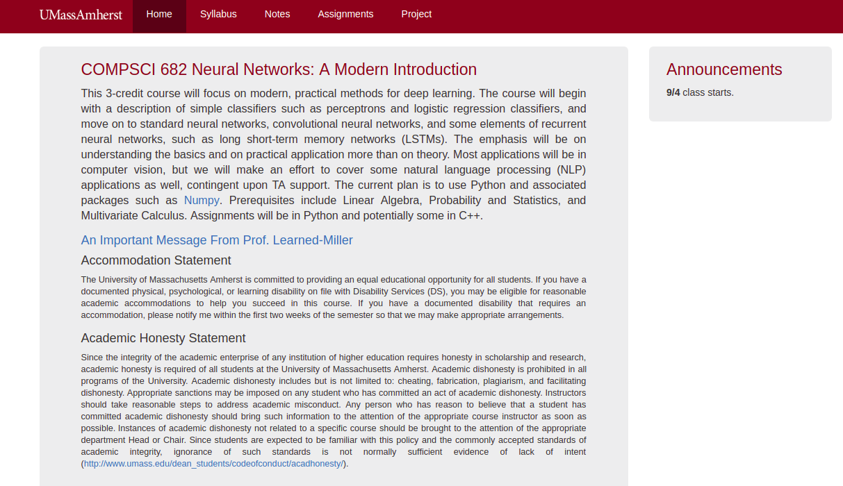
Course web page
https://compsci682-fa19.github.io/
OR …
Go to my web page (Google “Learned-Miller”)
Go to my teaching page
Click on top link

Slide 4
Piazza
Everyone needs to sign up for Piazza. This is how you get messages for the class.
Please post most questions there, rather than sending email to me or the TAs.
The TAs and I will answer questions posted to Piazza.

Slide 5
Python: Up and running
We’re using Python 3.6, not 2.7.
If you have not installed Python and tried a simple program yet, please do so as soon as possible.
Try loading up the first Python Notebook for Homework 1. Even if you don’t have time to do the assignment yet, at least make sure the Python Notebook is working properly. This will make sure you don’t incur a major delay later.
PYTHON Tutorial! See “Notes” tab of course web page. (Show Notes page).

Slide 6
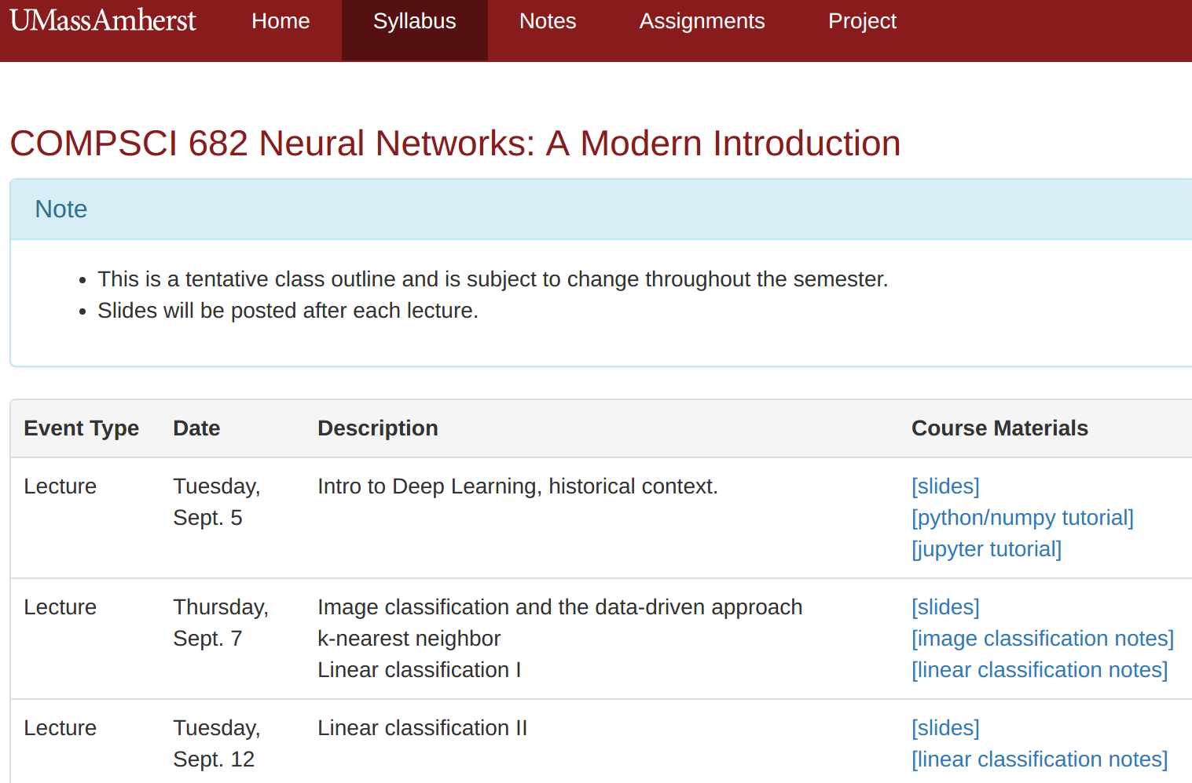
Readings
On Syllabus page,

Slide 7
Back to classification...

Slide 8
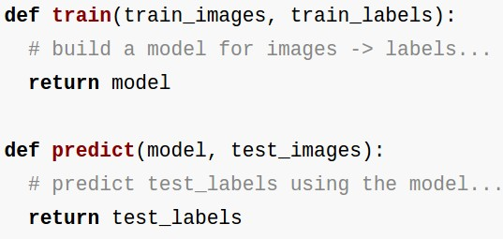
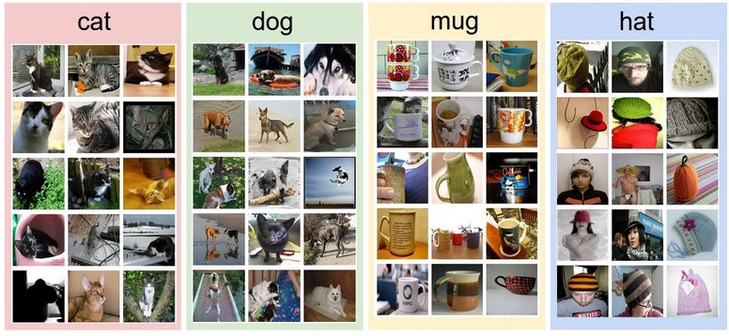
Data-driven approach:
Collect a dataset of images and labels
Use Machine Learning to train an image classifier
Evaluate the classifier on a withheld set of test images
Example training set

Slide 9
First classifier: Nearest Neighbor Classifier
Remember all training images and their labels
Predict the label of the most similar training image

Slide 10
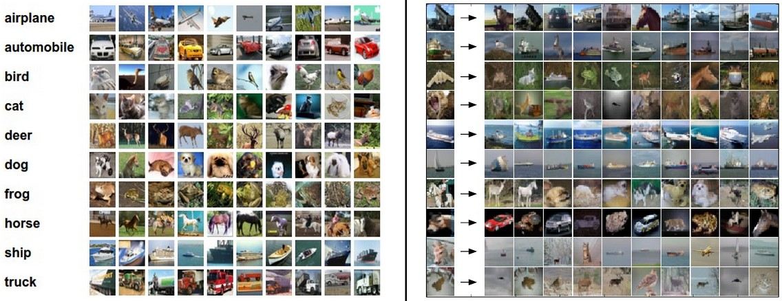
Example dataset: CIFAR-10
10 labels
50,000 training images, each image is tiny: 32x32
10,000 test images.

Slide 11
Example dataset: CIFAR-10
10 labels
50,000 training images
10,000 test images.
For every test image (first column), examples of nearest neighbors in rows

Slide 12
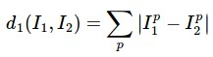
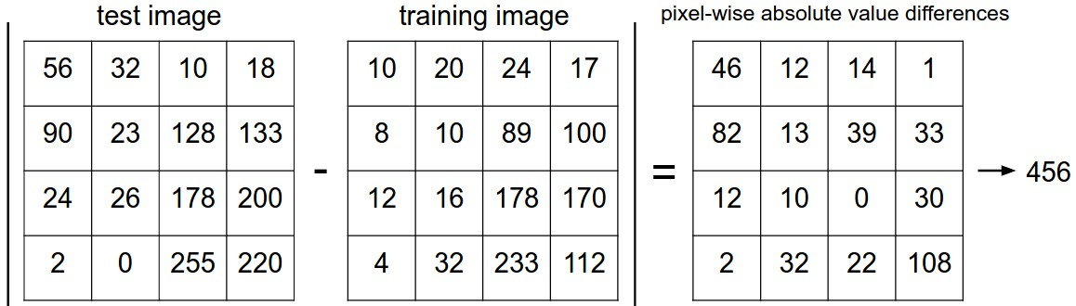
How do we compare the images? What is the distance metric?
L1 distance:
add

Slide 13
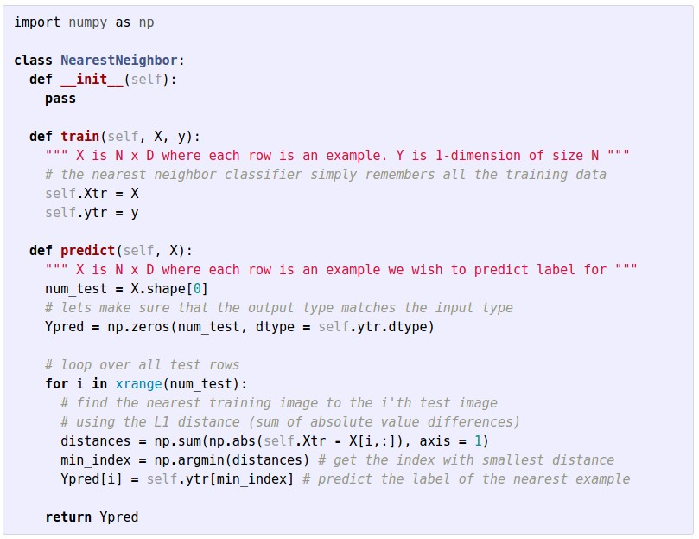
Nearest Neighbor classifier

Slide 14
Nearest Neighbor classifier
remember the training data

Slide 15
Nearest Neighbor classifier
for every test image:
find nearest train image with L1 distance
predict the label of nearest training image

Slide 16
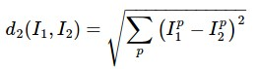
The choice of distance is a hyperparameter
common choices:
L1 (Manhattan) distance
L2 (Euclidean) distance

Slide 17
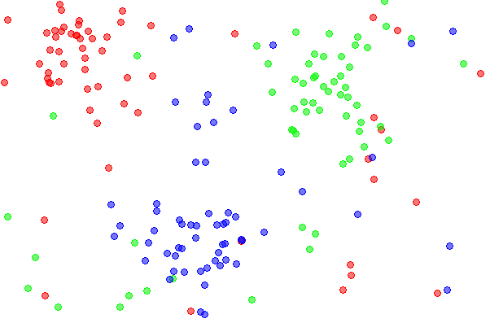
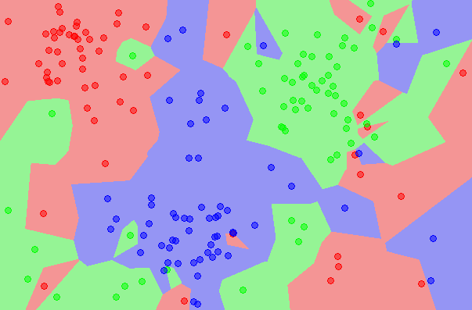
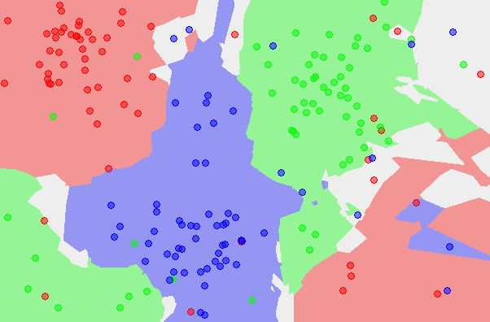
k-Nearest Neighbor
find the k nearest images, have them vote on the label
the data
NN classifier
5-NN classifier
http://en.wikipedia.org/wiki/K-nearest_neighbors_algorithm

Slide 18
Example dataset: CIFAR-10
10 labels
50,000 training images
10,000 test images.
For every test image (first column), examples of nearest neighbors in rows

Slide 19
the data
NN classifier
5-NN classifier
Q: what is the accuracy of the nearest neighbor classifier on the training data, when using the Euclidean distance?

Slide 20
the data
NN classifier
5-NN classifier
Q2: what is the accuracy of the k-nearest neighbor classifier on the training data?

Slide 21
What is the best distance to use?
What is the best value of k to use?
i.e. how do we set the hyperparameters?

Slide 22
What is the best distance to use?
What is the best value of k to use?
i.e. how do we set the hyperparameters?
Very problem-dependent.
Must try them all out and see what works best.

Slide 23
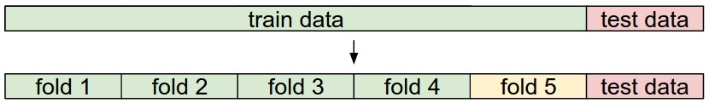
Try out what hyperparameters work best on test set.

Slide 24
Trying out what hyperparameters work best on test set:
Very bad idea. The test set is a proxy for the generalization performance!
Use only VERY SPARINGLY, at the end.

Slide 25
Validation data
use to tune hyperparameters

Slide 26
Cross-validation
cycle through the choice of which fold is the validation fold, average results.

Slide 27
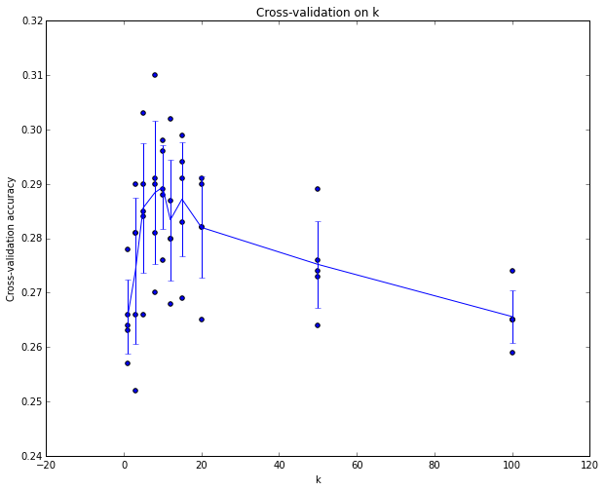
Example of
5-fold cross-validation
for the value of k.
Each point: single
outcome.
The line goes
through the mean, bars
indicated standard
deviation
(Seems that k ~= 7 works best
for this data)

Slide 28
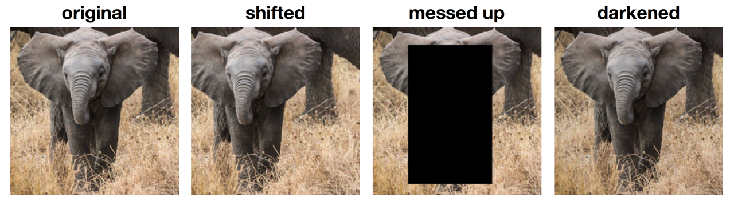
k-Nearest Neighbor on raw images is never used.
terrible performance at test time
distance metrics on level of whole images can be very unintuitive
(all 3 images have same L2 distance to the one on the left)

Slide 29
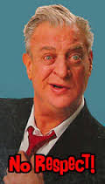
Before moving on
K-NN: the Rodney Dangerfield of classifiers
Convergence of K-NN to the Bayes error rate.
Universality of K-NN.

Slide 30
Linear Classification

Slide 31
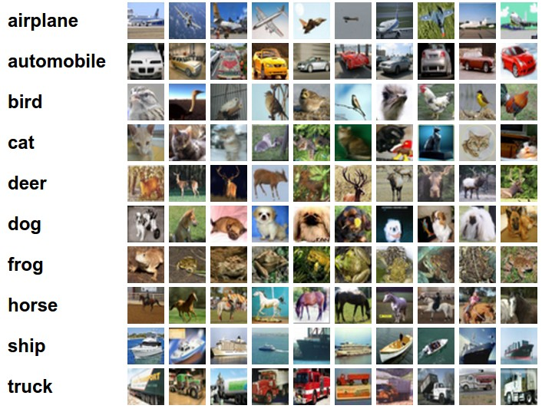
Example dataset: CIFAR-10
10 labels
50,000 training images
each image is 32x32x3
10,000 test images.

Slide 32
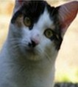
Parametric approach
image
parameters
f(x,W)
10 numbers, indicating class scores
[32x32x3]
array of numbers 0...1
(3072 numbers total)

Slide 33
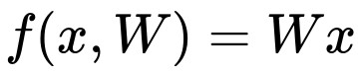
Parametric approach: Linear classifier
10 numbers, indicating class scores
[32x32x3]
array of numbers 0...1

Slide 34
Parametric approach: Linear classifier
3072x1
10x1
10x3072
10 numbers, indicating class scores
[32x32x3]
array of numbers 0...1
parameters, or “weights”

Slide 35
Parametric approach: Linear classifier
3072x1
(+b)
10x1
10x1
10x3072
10 numbers, indicating class scores
[32x32x3]
array of numbers 0...1
parameters, or “weights”

Slide 36
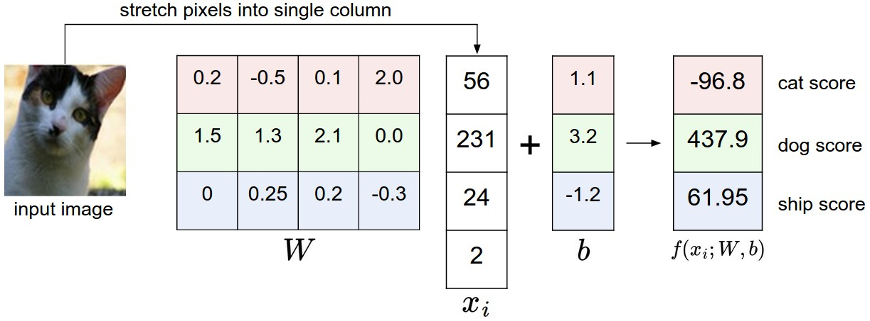
Example with an image with 4 pixels, and 3 classes (cat/dog/ship)

Slide 37
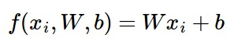
Interpreting a Linear Classifier
Q: what does the linear classifier do, in English?

Slide 38
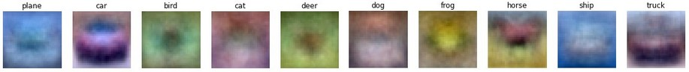
Interpreting a Linear Classifier
Example trained weights of a linear classifier trained on CIFAR-10:

Slide 39
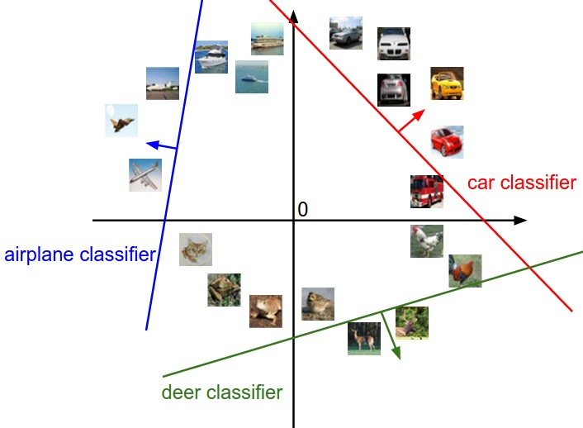
Interpreting a Linear Classifier
[32x32x3]
array of numbers 0...1
(3072 numbers total)

Slide 40
Interpreting a Linear Classifier
Q2: what would be a very hard set of classes for a linear classifier to distinguish?

Slide 41
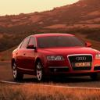
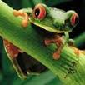
So far:
We defined a (linear) score function:
really affine
-3.45
-8.87
0.09
2.9
4.48
8.02
3.78
1.06
-0.36
-0.72
-0.51
6.04
5.31
-4.22
-4.19
3.58
4.49
-4.37
-2.09
-2.93
3.42
4.64
2.65
5.1
2.64
5.55
-4.34
-1.5
-4.79
6.14
Example class
scores for 3
images, with a
random W:

Slide 42
Coming up:
Loss function
Optimization
Neural nets!
(quantifying what it means to have a “good” W)
(start with random W and find a W that minimizes the loss)
(tweak the functional form of f)

Slide 43
Recall from last time… Linear classifier
image
parameters
10 numbers, indicating class scores
f(x,W)
[32x32x3]
array of numbers 0...1
(3072 numbers total)

Slide 44
Recall from last time… Going forward: Loss function/Optimization
TODO:
Define a loss function that quantifies our unhappiness with the scores across the training data.
Come up with a way of efficiently finding the parameters that minimize the loss function. (optimization)
-3.45
-8.87
0.09
2.9
4.48
8.02
3.78
1.06
-0.36
-0.72
-0.51
6.04
5.31
-4.22
-4.19
3.58
4.49
-4.37
-2.09
-2.93
3.42
4.64
2.65
5.1
2.64
5.55
-4.34
-1.5
-4.79
6.14

Slide 45
Suppose: 3 training examples, 3 classes.
With some W the scores are:
cat
3.2
1.3
2.2
car
5.1
4.9
2.5
-1.7
2.0
-3.1
frog

Slide 46
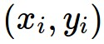
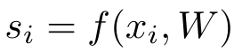

Suppose: 3 training examples, 3 classes.
With some W the scores are:
Multiclass SVM loss:
Given an example
where is the image and
where is the (integer) label,
and using the shorthand for the scores vector:
the SVM loss has the form:
cat
3.2
1.3
2.2
car
5.1
4.9
2.5
-1.7
2.0
-3.1
frog

Slide 47
Suppose: 3 training examples, 3 classes.
With some W the scores are:
Multiclass SVM loss:
Given an example
where is the image and
where is the (integer) label,
and using the shorthand for the scores vector:
the SVM loss has the form:
cat
3.2
1.3
2.2
car
5.1
4.9
2.5
= max(0, 5.1 - 3.2 + 1)
+max(0, -1.7 - 3.2 + 1)
= max(0, 2.9) + max(0, -3.9)
= 2.9 + 0
= 2.9
-1.7
2.0
-3.1
frog
Losses:
2.9

Slide 48
Suppose: 3 training examples, 3 classes.
With some W the scores are:
Multiclass SVM loss:
Given an example
where is the image and
where is the (integer) label,
and using the shorthand for the scores vector:
the SVM loss has the form:
cat
3.2
1.3
2.2
car
5.1
4.9
2.5
= max(0, 1.3 - 4.9 + 1)
+max(0, 2.0 - 4.9 + 1)
= max(0, -2.6) + max(0, -1.9)
= 0 + 0
= 0
-1.7
2.0
-3.1
frog
Losses:
2.9
0

Slide 49
Suppose: 3 training examples, 3 classes.
With some W the scores are:
Multiclass SVM loss:
Given an example
where is the image and
where is the (integer) label,
and using the shorthand for the scores vector:
the SVM loss has the form:
cat
3.2
1.3
2.2
car
5.1
4.9
2.5
= max(0, 2.2 - (-3.1) + 1)
+max(0, 2.5 - (-3.1) + 1)
= max(0, 6.3) + max(0, 6.6)
= 6.3 + 6.6
= 12.9
-1.7
2.0
-3.1
frog
Losses:
2.9
0
12.9

Slide 50
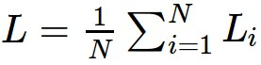
Suppose: 3 training examples, 3 classes.
With some W the scores are:
Multiclass SVM loss:
Given an example
where is the image and
where is the (integer) label,
and using the shorthand for the scores vector:
the SVM loss has the form:
and the full training loss is the mean over all examples in the training data:
cat
3.2
1.3
2.2
car
5.1
4.9
2.5
-1.7
2.0
-3.1
frog
L = (2.9 + 0 + 12.9)/3
= 5.3
Losses:
2.9
0
12.9

Slide 51
Suppose: 3 training examples, 3 classes.
With some W the scores are:
Multiclass SVM loss:
Given an example
where is the image and
where is the (integer) label,
and using the shorthand for the scores vector:
the SVM loss has the form:
Q: what if the sum was instead over all classes?
(including j = y_i)
cat
3.2
1.3
2.2
car
5.1
4.9
2.5
-1.7
2.0
-3.1
frog
Losses:
2.9
0
12.9

Slide 52
Suppose: 3 training examples, 3 classes.
With some W the scores are:
Multiclass SVM loss:
Given an example
where is the image and
where is the (integer) label,
and using the shorthand for the scores vector:
the SVM loss has the form:
Q2: what if we used a mean instead of a sum here?
cat
3.2
1.3
2.2
car
5.1
4.9
2.5
-1.7
2.0
-3.1
frog
Losses:
2.9
0
12.9

Slide 53
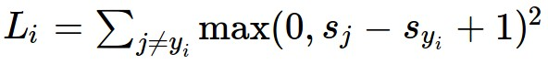
Suppose: 3 training examples, 3 classes.
With some W the scores are:
Multiclass SVM loss:
Given an example
where is the image and
where is the (integer) label,
and using the shorthand for the scores vector:
the SVM loss has the form:
Q3: what if we used
cat
3.2
1.3
2.2
car
5.1
4.9
2.5
-1.7
2.0
-3.1
frog
Losses:
2.9
0
12.9

Slide 54
Suppose: 3 training examples, 3 classes.
With some W the scores are:
Multiclass SVM loss:
Given an example
where is the image and
where is the (integer) label,
and using the shorthand for the scores vector:
the SVM loss has the form:
Q4: what is the min/max possible loss?
cat
3.2
1.3
2.2
car
5.1
4.9
2.5
-1.7
2.0
-3.1
frog
Losses:
2.9
0
12.9

Slide 55
Suppose: 3 training examples, 3 classes.
With some W the scores are:
Multiclass SVM loss:
Given an example
where is the image and
where is the (integer) label,
and using the shorthand for the scores vector:
the SVM loss has the form:
Q5: usually at initialization W are small numbers, so all s ~= 0. What is the loss?
cat
3.2
1.3
2.2
car
5.1
4.9
2.5
-1.7
2.0
-3.1
frog
Losses:
2.9
0
12.9

Slide 56
